Slide 1
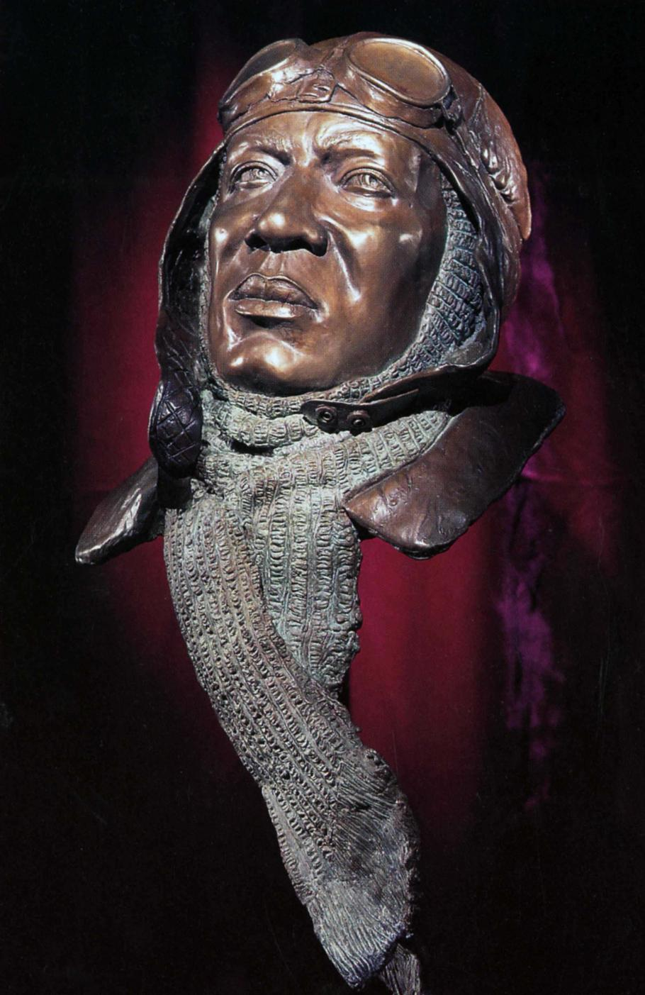
In 1992, the McDonnell Douglas Corporation donated to the National Air and Space Museum a bronze portrait head of Bullard, created by Eddie Dixon, an African American sculptor. This work is displayed in the museum’s Legend, Memory and the Great War in the Air gallery.

